Slide 1
CSGY-6083 Principle of Database Systems
Tiger Teng
Notes:
Hello, I’m Tiger, thank you for watching my presentation. Here I’m going to present about my project database that I’ve made.

Slide 2
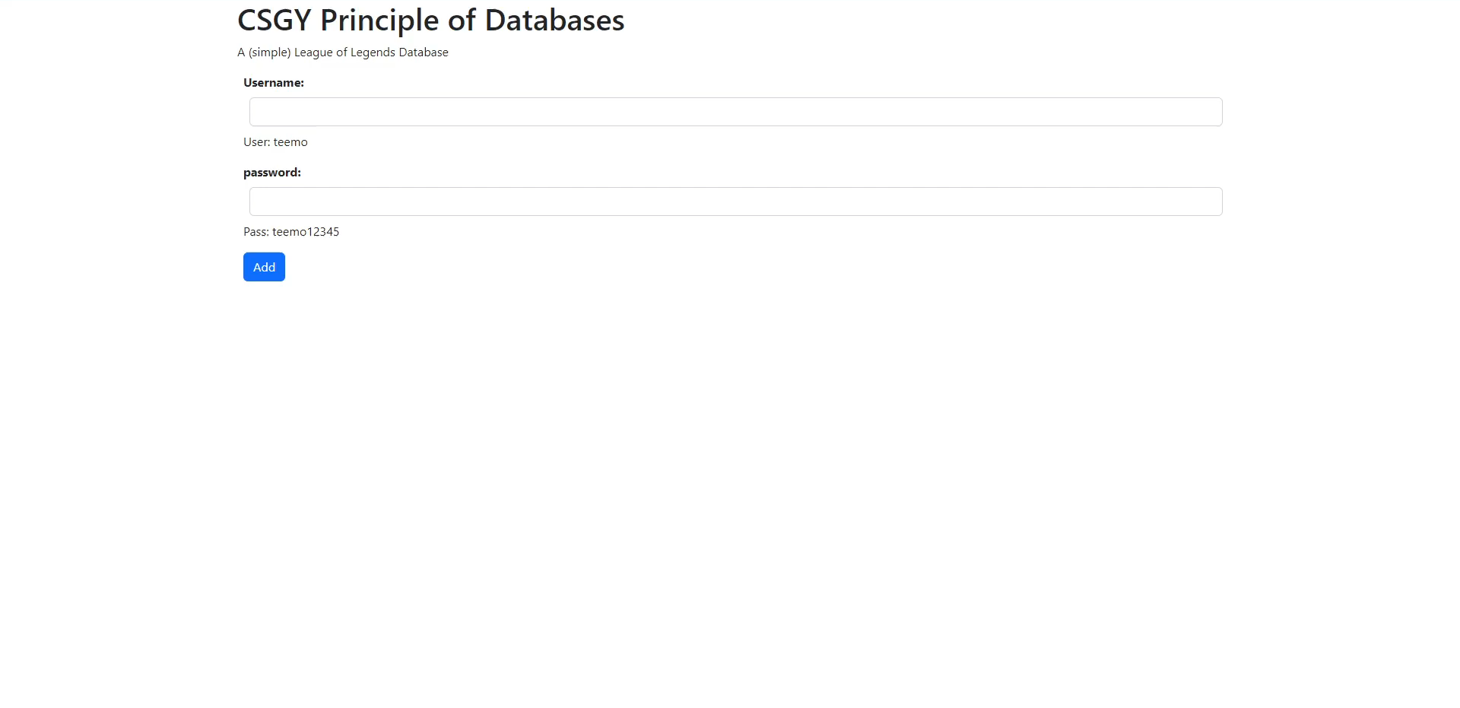
A (simple) League of Legends database
Notes:
So my database is for the relative popular game called League of Legends. The primary goal of this database is to give simple or brief information about the game and in a way keep track of all the changes the company decides to push out (like, new champions, renaming skins, adjusting item values, or removing items completely). In the video, I’m showing you all the tables that you can navigate to in the database and the various tables you can add, update, or delete data from.

Slide 3
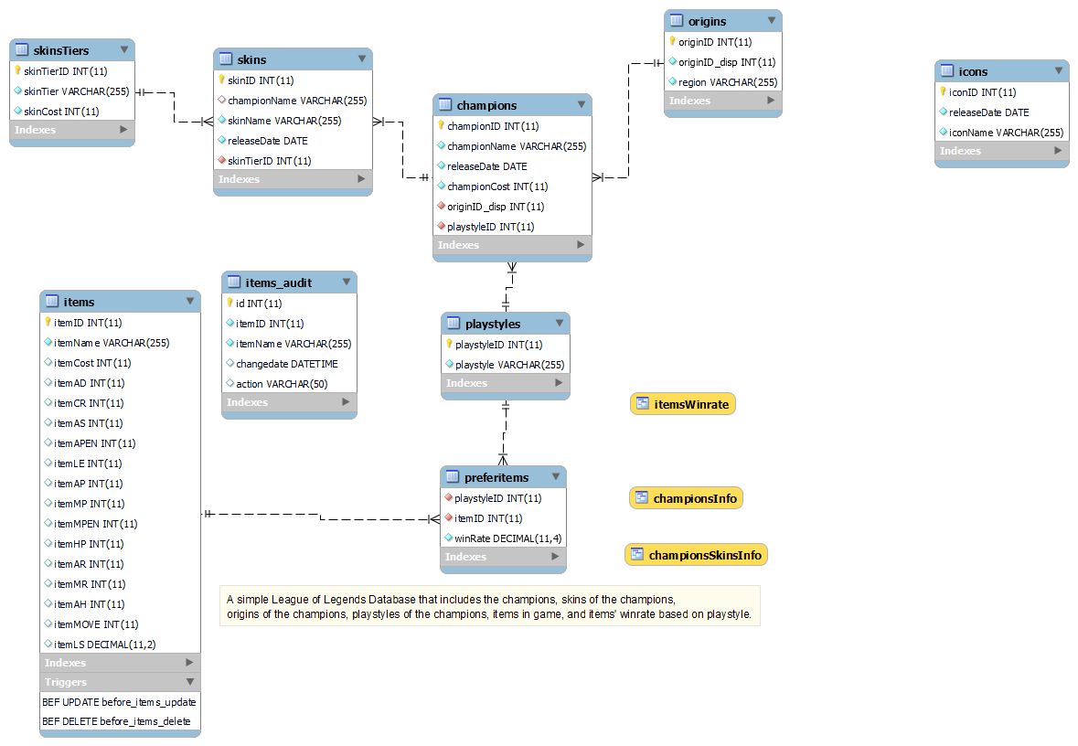
Tables
Notes:
For my database, I decided to take a wayyyy simpler approach since there are many many other attributes to some of the tables like in the items table there are some info that I didn’t include that does exist in the game or that champions have short descriptions associated with them in the game (or even the fact that each champions have abilities and stats). However, I’m still able to translate the game into 7 tables mainly pertaining to the 3 main ideas from the game; skins, champions, and items.

Slide 4
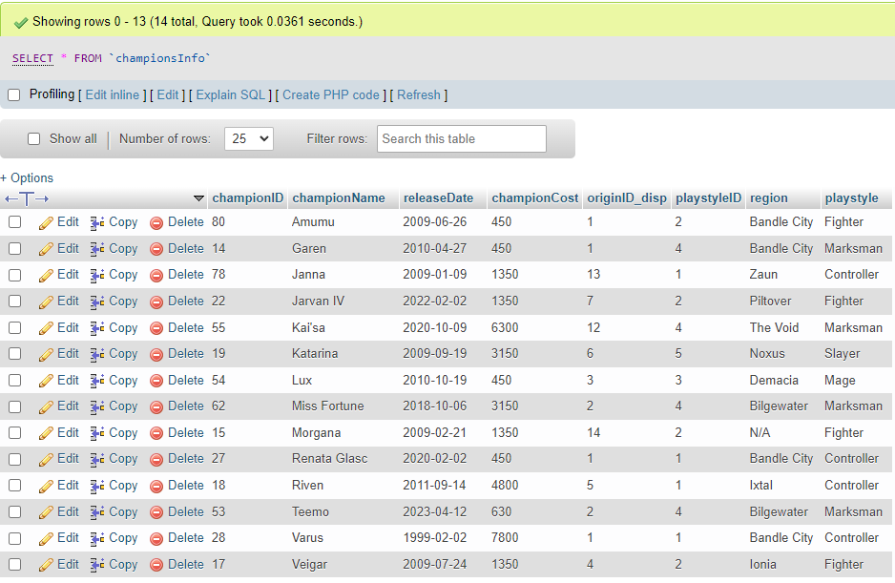
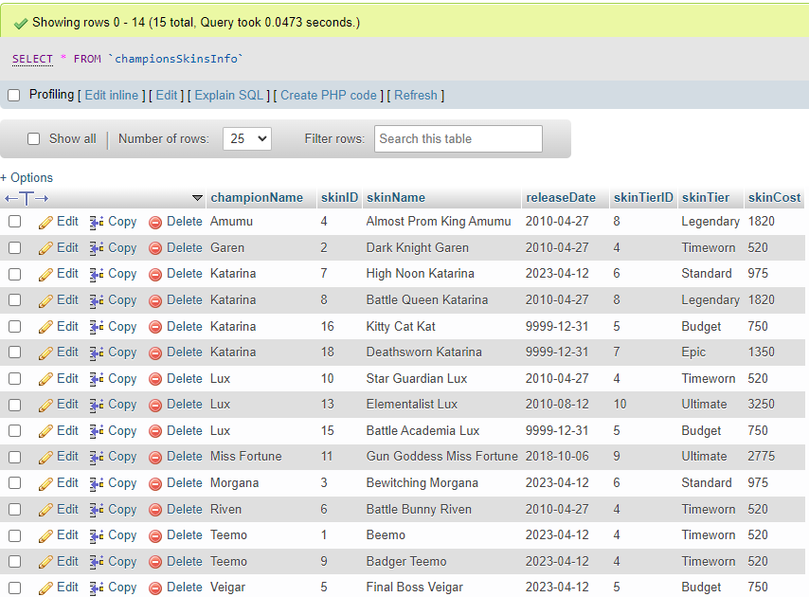
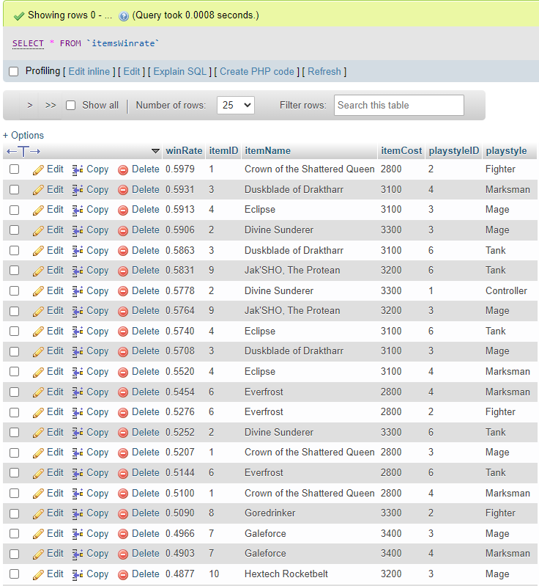
Views
Notes:
From the tables, I created 3 different views so that it’ll be easier for me to recall the information from the database on the website; championInfo, championSkinsInfo, and itemsWinrate.

Slide 5
Views
CREATE VIEW itemsWinrate AS
SELECT `preferitems`.`winRate`, `items`.`itemID`, `items`.`itemName`, `items`.`itemCost`, `playstyles`.`playstyleID`, `playstyles`.`playstyle`
FROM `preferitems`
LEFT JOIN `items` ON `preferitems`.`itemID` = `items`.`itemID`
LEFT JOIN `playstyles` ON `preferitems`.`playstyleID` = `playstyles`.`playstyleID`
ORDER BY `preferitems`.`winRate` DESC;
CREATE VIEW championsInfo AS
SELECT c.championID, c.championName, c.releaseDate, c.championCost, c.originID_disp, c.playstyleID, o.region, p.playstyle
FROM `champions` AS `c`
LEFT JOIN `playstyles` AS `p` ON `c`.`playstyleID` = `p`.`playstyleID`
LEFT JOIN `origins` AS `o` ON `c`.`originID_disp` = `o`.`originID_disp`
ORDER BY `c`.`championName` ASC;
Notes:
Here is the code that is used to generate 2 of the 3 views.

Slide 6
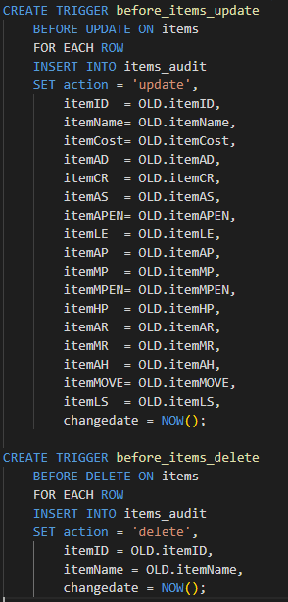
Triggers
Notes:
The game periodically updates with changes made to items or champions, but since I decided to not handle champions stats in game, items will be the only thing that changes periodically in the database. Because it changes so often and I want to keep track of what the items’ stats were before the change should the game devs decide to revert the changes, I created the item_audit table that updates based on these triggers. If an item was updated in the items table, it will create an entry in the items_audit table with the original values.

Slide 7
Normalization
First Normal Form (1NF)
1. Using row order to convey information is not permitted
2. Mixing data types within the same column is not permitted
3. Having a table without primary key is not permitted
4. Repeating groups are not permitted
Notes:
Now all of my tables fall under the first normal form as you can see SHOW TABLES IN PHPMYADMIN none of the tables violate these four rules for the first normal form. The tables do not use row order to convey any information, there’s no data type mixes, every table has a primary key, and there’s no repeated groups

Slide 8
Normalization
Second Normal Form (2NF)
Each non-key attribute in the table must be dependent on the entire primary key
Notes:
For the second normal form all my tables are also in the second normal form as each of the non-key columns in the table are entirely dependent on the entire primary key. SHOW TABLES IN PHPMYADMIN AND EXPLAIN COLUMNS

Slide 9
Normalization
Second Normal Form (2NF)
Each non-key attribute in the table must be dependent on the entire primary key
Third Normal Form (3NF)
Each non-key attribute in the table must depend on the key, the whole key, and nothing but the key meaning no transitive dependency.
Notes:
Similar to the second normal form, all my tables are also in the third normal form as none of the tables show transitive dependency. SHOW SKINS and SKINTIER IN PHPMYADMIN AND EXPLAIN COLUMNS

Slide 10
Integrity Enforcement
Entity integrity:
Ensuring that each row of a table has a unique and non-null primary key value; this is the same as saying that each row in a table represents a single instance of the entity type modelled by the table.
Notes:
My database also has integrity enforcement through the uses of keys. To enforce entity integrity, I implemented a primary key to each table so that we will always have a unique entry even if something is duplicated (i.e. if a champion has multiple skins, the skin name and the skinID uniquely identifies each skin a champion has, or if multiple items have the same cost, the itemID and the item Name will uniquely identifies each items).

Slide 11
Integrity Enforcement
Entity integrity:
Ensuring that each row of a table has a unique and non-null primary key value; this is the same as saying that each row in a table represents a single instance of the entity type modelled by the table.
Referential integrity:
Any column in a base table that declared a foreign key can only contain either null values or values from a parent table's primary key or a candidate key.
Notes:
To enforce referential integrity, I implemented a foreign keys to some of the tables so that we will always have a relation between the two tables should something gets updated, inserted, or deleted
(for example, (SKINS TABLE SHOW EXAMPLE) any skin references the champion’s name in the skins database, so if we were to remove any champions, the skins should also be removed since it cannot references a non-existing champion. If I delete Teemo from the database from the champions table, all Teemo skins should be deleted as well since we set the foreign key to cascade upon deletion. Any insertion here is also not allowed if it does not reference an existing champions like if I were to try to insert a skin for Ivern, it will not allow me since Ivern doesn’t exist in the database.

Slide 12
Integrity Enforcement
Entity integrity:
Ensuring that each row of a table has a unique and non-null primary key value; this is the same as saying that each row in a table represents a single instance of the entity type modelled by the table.
Referential integrity:
Any column in a base table that declared a foreign key can only contain either null values or values from a parent table's primary key or a candidate key.
Domain integrity:
Rules and other processes restricting the format, type, and volume of data recorded in a database. It ensures that every column in a relational database is in a defined domain
Notes:
To enforce domain integrity, in each of the php files, I restricted the type of input allowed so that it can only insert data into the table using the correct data type.
(for example, (SHOW EXAMPLE) for the origins and playstyles in the champion creation, I cannot input any letters since this can only input integers which will reference the originID from the origins table. I decided not to implement this input using text as users could easily mistype a letter as these names are not common words, but numbers are much more forgiving)

Slide 13
Isolation Level
Dirty Read – A Dirty read is a situation when a transaction reads data that has not yet been committed.
Non Repeatable read – Non Repeatable read occurs when a transaction reads the same row twice and gets a different value each time.
Phantom Read – Phantom Read occurs when two same queries are executed, but the rows retrieved by the two, are different.
Notes:
I want to set the database to a serializable isolation level, but Hostinger default isolation level is repeatable read. So for it being a repeatable read isolation level, if multiple people want to input, for example champions, into the database, I do not want users to be able to read any uncommitted data (which is dirty read), and not be able to reads the same row twice and gets a different value each time during one transaction (which is non-repeatable read) However, phantom reads are still allowed which I do not want.

Slide 14
Isolation Level
DELIMITER //
CREATE FUNCTION skinLimit(skinchampionName VARCHAR(255)) RETURNS INT
BEGIN
DECLARE skinlimit INT;
SET skinlimit = (SELECT count(*) FROM skins WHERE skinchampionName = championName);
RETURN skinlimit;
END//
DELIMITER ;
DELIMITER //
CREATE PROCEDURE skinInsert(IN championName, IN skinName, IN releaseDate, IN skinTier, OUT status)
BEGIN
SET TRANSACTION ISOLATION LEVEL SERIALIZABLE;
if skinLimit(championName) < 4 THEN
INSERT INTO skins (championName, releaseDate, skinName, skinTierID) VALUES
(championName, releaseDate, skinName, skinTier);
SET status = 'skin added';
ELSE
SET status = 'This champion has too many skins';
END IF;
COMMIT;
END;
DELIMITER ;
Notes:
For inserting skins, I’ve set a different isolation levels using both a procedure and a function that limits the amount of skins a champion can have. Since for my database, I do not want any more than 4 skins per champion, I’ve set the isolation level at serializable to prevent concurrent transaction from populating the table to 5+ skins.

